Slide 1
Advance Shell Scripting

Slide 2
Topics
Command Concepts, File Permissions
Variable/Operator
Conditional Statements
Loops/Loop Controls
Functions
I/O Redirection
Process Management
Regular Expression
Utilities : grep, sed, find and awk
Compression Techniques
Archiving
Job Scheduling

Slide 3
DAY 1
Do your favourite thing once in a while – after waking up, when you have 5 free minutes at home, when alone in your office. Fill yourself with love, joy and passion. Dance, sing, exercise, draw, write, read and do everything that will start your day actively. Be lively, full of energy and life and take that mood with you wherever you go

Slide 4

Command Concepts
ls → Command name
-al → Options(usually preceded by a dash)
Templates/ → Argument (often a filename or directory)
Note : “man” and “info” are the commands to read the command manual

Slide 5
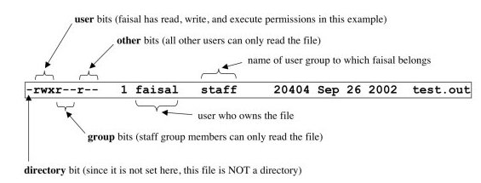
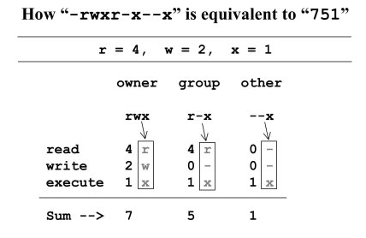
File Permissions
Command Used to Change owner and permission are “chown” and “chmod””

Slide 6
What are Shells
Definition : - “Shell is a UNIX term for the interactive user interface with an operating system. The shell is the layer of programming that understands and executes the commands a user enters. In some systems, the shell is called a command interpreter. ”
Different types of shells : bourne shell(sh), C shell (csh), tcsh, korn shell(ksh) and bourne again shell(bash), Z shell (zsh)
To know your shell use command : echo “$SHELL”

Slide 7
Variables in Unix
Variables are symbolic names that represent values stored in memory.
Global Variables : environment and configuration variables. ex: HOSTNAME, SHELL, PS1 etc. (command to check the environment variable list “printenv”)
Local Variables : Within a shell script, you can create as many new variables as needed. Any variable created in this manner remains in existence only within that shell.
Special Variables : A script can export variables only to child processes i.e, only to commands or processes which that particular script initiates. ex : $0, $1 … $n, $@, $#, $*, $?, $$
Lets see how variable assignment happens and what does the : - echo, read, readonly, unset command do.

Slide 8
Operators
Arithmetic Operators : +, -, *, /, **, %
let var=10**2
var=$((10**2))
echo 2^100 | bc
Logical Operators :
NOT
if [ ! -f $FILENAME ]
then ...
AND
if [ $condition1 ] && [ $condition2 ]
# Same as: if [ $condition1 -a $condition2 ]
# Returns true if both condition1 and condition2 hold true...
if [[ $condition1 && $condition2 ]] # Also works.
OR
if [ $condition1 ] || [ $condition2 ]
# Same as: if [ $condition1 -o $condition2 ]
# Returns true if either condition1 or condition2 holds true...
if [[ $condition1 || $condition2 ]] # Also works.

Slide 9
Continued…Operators
Bit Wise Operator : &, |,~, ^, >>, <<
Examples :
echo $((1<<4))
0001
0* 2^3 + 0*2^2 + 0*2^1 + 1*2^0
0+0+0+1 = 1
10000
1* 2^4 + 0* 2^3 + 0*2^2 + 0*2^1 + 0*2^0
16 + 0 + 0 + 0 = 16
echo $((255 & 7))
255 : 11111111
7 : 00000111
bitwise AND:00000111
echo $((255 | 7))
255 : 11111111
7 : 00000111
bitwise OR: 11111111
Notes:
1010 1100 -------- OR 1110
1010 1100 ------- AND 1000
-------- NOT 0110
0101 0110 ------ XOR 0011
Left shift Operator – <<
1<<4
Position 7 6 5 4 3 2 1 0
Bits 0 0 0 0 0 0 0 1
Position 7 6 5 4 3 2 1 0
Bits 0 0 0 1 0 0 0 0
Left shift Operator – <<
8>>1
Position 7 6 5 4 3 2 1 0
Bits 0 0 0 0 1 0 0 0
Position 7 6 5 4 3 2 1 0
Bits 0 0 0 0 0 1 0 0

Slide 10
Continued…Operators
Comparison Operators
String and numeric comparisons used with test or [[ ]] which is an alias for test and also [ ] which is another acceptable syntax
string1 = string2 True if strings are identical
string1 == string2 …ditto….
string1 !=string2 True if strings are not identical
string Return 0 exit status (=true) if string is not null
-n string Return 0 exit status (=true) if string is not null
-z string Return 0 exit status (=true) if string is null
int1 –eq int2 Test identity
int1 –ne int2 Test inequality
int1 –lt int2 Less than
int1 –gt int2 Greater than
int1 –le int2 Less than or equal
int1 –ge int2 Greater than or equal
Notes:
-d file Test if file is a directory
-f file Test if file is not a directory
-s file Test if the file has non zero length
-r file Test if the file is readable
-w file Test if the file is writable
-x file Test if the file is executable
-o file Test if the file is owned by the user
-e file Test if the file exists
-z file Test if the file has zero length
All these conditions return true if satisfied and false otherwise.
If [[ -e /home/dkumar/script.sh && -f /home/dkumar/script.sh ]]
Name=‘string’
If [ -z $name ]
Then
True code bolck
Else
False code block
fi

Slide 11
Decision Logic
#!/bin/bash
if [ “$#” -ne 2 ] then
echo $0 needs two parameters!
echo You are inputting $# parameters.
else
par1=$1
par2=$2
fi
echo $par1
echo $par2
Notes:
Num1 > num2 and num1 > 20

Slide 12
Continues…Decision Logic
#! /bin/bash
# number is positive, zero or negative
echo –e "enter a number: "
read number
if [ “$number” -lt 0 ]
then
echo "negative"
elif [ “$number” -eq 0 ]
then
echo zero
else
echo positive
fi

Slide 13
DAY 2
Tell me and I'll forget. Show me, and I may not remember. Involve me, and I'll understand.

Slide 14
Loops : While
while [ condition ]
do
command1
command2
commandN
done
The condition is evaluated, and if the condition is true, the command is executed
This repeats until the condition becomes false.
The condition can be integer ($i < 5), file test ( -e /tmp/lock ) or string ( $ans != "" )
Notes:
BASH while Loop Example
#!/bin/bash
c=1
while [ $c -le 5 ]
do
echo "Welcome $c times"
(( c++ ))
done
KSH while loop Example
#!/bin/ksh
c=1
while [[ $c -le 5 ]];
do
echo "Welcome $c times"
(( c++ ))
done
CSH while loop Example
#!/bin/csh
c=1
while ( $c <= 5 )
echo "Welcome $c times"
@ c = $c + 1
end
Read file
#!/bin/bash
file=/etc/resolv.conf
while IFS= read -r line
do
# echo line is stored in $line
echo $line
done < "$file"
Read file by field
#!/bin/bash
file=/etc/resolv.conf
# set field separator to a single white space
while IFS=' ' read -r f1 f2
do
echo "field # 1 : $f1 ==> field #2 : $f2"
done < "$file"

Slide 15
Loops : Until
until [ condition ]
do
command1
command2
...
....
commandN
done
Note : The until loop executes until a nonzero status is returned
Notes:
#!/bin/bash
i=1
until [ $i -gt 6 ]
do
echo "Welcome $i times."
i=$(( i+1 ))
done

Slide 16
Loops : for
for var in item1 item2 ... itemN
do
command1
command2
....
...
commandN
done
The for loop three-expression syntax ( this type of for loop share a common heritage with the C programming language )
for (( EXP1; EXP2; EXP3 ))
do
command1
command2
command3
done
Notes:
#!/bin/bash
for i in 1 2 3 4 5
do
echo "Welcome $i times."
done
The For Loop Using Strings
#!/bin/bash
# A simple shell script to print list of cars
for car in bmw ford toyota nissan
do
echo "Value of car is: $car"
done
executing commnads
#!/bin/bash
# A simple shell script to run commands
for command in date pwd df
do
echo
echo "*** The output of $command command >"
#run command
$command
echo
done
The For Loop Using Variable's Contents
#!/bin/bash
# A shell script to verify user password database
files="/etc/passwd /etc/group /etc/shadow /etc/gshdow"
for f in $files
do
[ -f $f ] && echo "$f file found" || echo "*** Error - $f file missing."
done
The For Loop Using Command-line Arguments
#!/bin/bash
# A simple shell script to display a file on screen passed as command line argument
[ $# -eq 0 ] && { echo "Usage: $0 file1 file2 fileN"; exit 1; }
# read all command line arguments via the for loop
for f in $*
do
echo
echo "< $f >"
[ -f $f ] && cat $f || echo "$f not file."
echo "------------------------------------------------"
done
The for loop using command substitution
#!/bin/bash
echo "Printing file names in /tmp directory:"
for f in $(ls /tmp/*)
do
echo $f
done
The for loop using ranges or counting
#!/bin/bash
n=$1
# make sure command line arguments are passed to the script
if [ $# -eq 0 ]
then
echo "A shell script to print multiplication table."
echo "Usage : $0 number"
exit 1
fi
# Use for loop
for i in {1..10}
do
echo "$n * $i = $(( $i * $n))"
done

Slide 17
Loops : case
varName=“pattern1”
case $varName in
pattern1) command1;;
pattern2) command2;;
pattern1) command3;;
*) echo "Error select option 1..3";;
esac
Notes:
Case example :
#!/bin/bash
# Check 3 arguments are given #
if [ $# -lt 3 ]
then
echo "Usage : $0 option pattern filename"
exit
fi
# Check the given file is exist #
if [ ! -f $3 ]
then
echo "Filename given \"$3\" doesn't exist"
exit
fi
case "$1" in
# Count number of lines matches
-i) echo "Number of lines matches with the pattern $2 :"
grep -c -i $2 $3
;;
# Count number of words matches
-c) echo "Number of words matches with the pattern $2 :"
grep -o -i $2 $3 | wc -l
;;
# print all the matched lines
-p) echo "Lines matches with the pattern $2 :"
grep -i $2 $3
;;
# Delete all the lines matches with the pattern
-d) echo "After deleting the lines matches with the pattern $2 :"
sed -n "/$2/!p" $3
;;
*) echo "Invalid option"
;;
esac

Slide 18
Loops : select
select varName in list
do
command1
command2
....
......
commandN
done
Notes:
#!/bin/bash
# Set PS3 prompt
PS3="Enter the space shuttle to get quick information : "
# set shuttle list
# exit option
select shuttle in columbia endeavour challenger discovery atlantis enterprise pathfinder mangalyaan exit
do
case $shuttle in
columbia)
echo "--------------"
echo "Space Shuttle Columbia was the first spaceworthy space shuttle in NASA's orbital fleet."
echo "--------------"
;;
endeavour)
echo "--------------"
echo "Space Shuttle Endeavour is one of three currently operational orbiters in the Space Shuttle."
echo "--------------"
;;
challenger)
echo "--------------"
echo "Space Shuttle Challenger was NASA's second Space Shuttle orbiter to be put into service."
echo "--------------"
;;
discovery)
echo "--------------"
echo "Discovery became the third operational orbiter, and is now the oldest one in service."
echo "--------------"
;;
atlantis)
echo "--------------"
echo "Atlantis was the fourth operational shuttle built."
echo "--------------"
;;
enterprise)
echo "--------------"
echo "Space Shuttle Enterprise was the first Space Shuttle orbiter."
echo "--------------"
;;
pathfinder)
echo "--------------"
echo "Space Shuttle Orbiter Pathfinder is a Space Shuttle simulator made of steel and wood."
echo "--------------"
;;
mangalyaan)
echo "--------------"
echo "The Mars Orbiter Mission (MOM), also called Mangalyaan. It was launched on 5 November 2013 by the Indian Space Research Organisation (ISRO)"
echo "--------------"
;;
exit)
echo "Bye!"
break
;;
*)
echo "Error: Please try again (select 1..8)!"
;;
esac
done

Slide 19
Loop Control : Break
Use the break statement to exit from within a for, while, until loop i.e. stop loop execution.
Example :
#!/bin/bash
i=1
while [[ $i -le 10 ]]
do
if [[ $i -eq 5 ]]
then
echo "I want to take a BREAK from here as i got the value 5"
break
fi
echo "Before each loop increment : $i"
i=$(($i+1))
echo "After the increment in the loop : $i"
done

Slide 20
Loop Control : Continue
The continue statement is used to resume the next iteration of the enclosing for, while or until loop
...
..
for i in something
do
[ condition ] && continue
cmd1
cmd2
done
..
...
Notes:
#!/bin/bash
i=1
while [[ $i -le 10 ]]
do
echo "Before each loop increment : $i"
i=$(($i+1))
if [[ $i -eq 5 ]]
then
echo "I want to take a skip iteration 5 from here as i got the value 5"
continue
fi
echo "After the increment in the loop : $i"
done

Slide 21
Functions
Syntax :
function_name()
{
Command1
Command2
…..
…..
Command N
}
Notes:
#!/bin/bash
# Define your function here
Welcome ()
{ echo “Welcome $1 to unix class"
return 10
}
# Invoke your function
Welcome Students
# Capture value returned by last command
ret=$?
echo "Return value is $ret“
-------variable scoping--------
#!/bin/bash
myfunc()
{
echo "I was called as : $@"
x=2
}
### Main script starts here
echo "Script was called with $@"
x=1
echo "x is $x"
myfunc 1 2 3
echo "x is $x"

Slide 22
Process Management
Command | Description
bg | To send a process to background
fg | To run a stopped process in foreground
top | Details on all Active Processes
ps | Give the status of processes running for a user
kill PID | Kills a process
nice | Starts a process with a given priority
renice | Changes priority of an already running process
df | Gives free hard disk space on your system
free | Gives free RAM on your system

Slide 23
DAY 3
When asked what learning was the most necessary, he said, 'Not to unlearn what you have learned

Slide 24
I/O Redirection
Output Redirection
The output from a command normally intended for standard output can be easily diverted to a file instead. This capability is known as output redirection:
If the notation > file is appended to any command that normally writes its output to standard output, the output of that command will be written to file instead of your terminal:
$ who > users
Append:
You can use >> operator to append the output in an existing file as follows:
$ who >> users

Slide 25
I/O Redirection
Input Redirection
The commands that normally take their input from standard input can have their input redirected from a file in this manner.
$ wc -l < users
Here Document:
A here document is used to redirect input into an interactive shell script or program.
We can run an interactive program within a shell script without user action by supplying the required input for the interactive program, or interactive shell script.
command << delimiter
Document
delimiter
Notes:
$wc -l << EOF
This is a simple lookup program
for good (and bad) restaurants
in Cape Town.
EOF
---------------------------------
sqlplus /nolog << SQL
CONNECT scott/tiger
SPOOL /u01/emp.lst
SET LINESIZE 100
SET PAGESIZE 50
SELECT * FROM emp;
SPOOL OFF
EXIT;
SQL

Slide 26
I/O Redirection
$wc -l << EOF
This is a simple lookup program
for good (and bad) restaurants
in Cape Town.
EOF
---------------------------------
sqlplus /nolog << SQL
CONNECT scott/tiger
SPOOL /u01/emp.lst
SET LINESIZE 100
SET PAGESIZE 50
SELECT * FROM emp;
SPOOL OFF
EXIT;
SQL

Slide 27
Regular Expression
* means "0 or more of the previous thing"
+ means "1 or more of the previous thing"
? means "0 or 1 of the previous thing".
‘.’ matches any single character!
These characters do not match themselves.
These greedy character modify whatever precedes them in the regular expression.
What if we want to match '.' ?
Throw in a slash (called "escaping").
f\. matches any string that contains an 'f'
followed by a period.
will match "d. e. r. f. ", but not "fred"
Notes:
Grep ro+t
b
a
baa
abc
cccab
aaaab

Slide 28
Regular Expression
Character Class
Sometimes we want to be able to match any character in a set of characters.
Put a list of the characters in your set inside square brackets:
[abc] matches any single character that is an 'a', 'b' or 'c'.
[abcdefghijklmnopqrstuvwxyz] matches any lowercase alphabetic char.
You can do this: [a-z] or [0-9] or [a-zA-z] or even [a-cf-k0-5B-K]
Make the first character in the square brackets '^'. Now it means "any character not in this set.
[^abc] any character except 'a', 'b' or 'c'.
[^aeiou] any character other than a lowercase vowel.

Slide 29
Utilities : grep
Search for the given string in a single file
$ grep "literal_string" filename
Checking for the given string in multiple files.
$ grep "this" demo_*
Case insensitive search using grep -i
$ grep -i "string" FILE
Match regular expression in files
$ grep "lines.*empty" demo_file
Checking for full words, not for sub-strings using grep -w

Slide 30
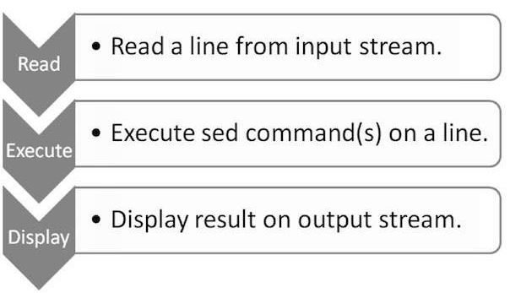
Utilities : sed
SED can be used in many different ways, such as:
Text substitution,
Selective printing of text files,
In-a-place editing of text files,
Non-interactive editing of text files, and many more.

Slide 31
Utilities : sed
SED supports the following standard options:
-n: Default printing of pattern buffer. For example, the following SED command does not show any output:
$sed -n '' passwd
-e : Next argument is an editing command. Here, angular brackets imply mandatory parameter. By using this option, we can specify multiple commands. Let us print each line twice:
$sed -e '' -e 'p' passwd
-f : Next argument is a file containing editing commands. The angular brackets imply mandatory parameter. In the following example, we specify print command through file:
$echo "p" > commands
$sed -n -f commands passwd
Notes:
Sed –n ‘1~2p’

Slide 32
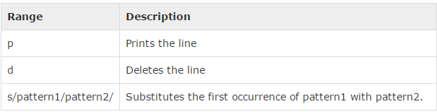
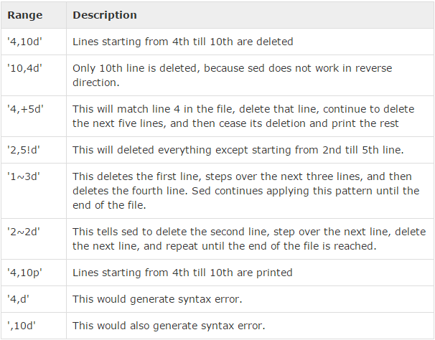
Utilities : sed
Notes:
cat /etc/passwd | sed '1, 5d' |more
cat /etc/passwd | sed -n '1,3p‘
sed -n '/pattern/, 5 p' /etc/passwd
sed -n '/The/,$ p’ /etc/passwd
sed -n 'w text.bak' text.txt
sed -n '2~2 w even.txt' /etc/passwd
sed '4 a My New Line entry' text.txt
Substitution :
cat /etc/passwd | sed 's/root/amrood/‘
cat /etc/passwd | sed 's:/root:/amrood:g'

Slide 33
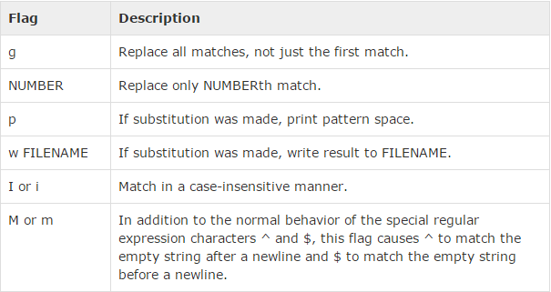
Utilities : sed
Ampersand Referencing
sed -e 's/^[[:digit:]][[:digit:]][[:digit:]]/(&)/g' phone.txt
phone.txt should contain numbers in each line : 9324567890
sed -e 's/^[[:digit:]]\{3\}/(&)/g' -e 's/)[[:digit:]]\{3\}/&-/g' phone.txt
Back reference
cat phone.txt | sed 's/\(.*)\)\(.*-\)\(.*$\)/Area code: \1 Second: \2 Third: \3/'
Notes:
0- 9 - [0-9] [[:digit:]]
AlphaNum [A-Za-z0-9] [[:ALPHNUM]]
[^a-c]
cat /etc/passwd | sed '1, 5d' |more
cat /etc/passwd | sed -n '1,3p‘
sed -n '/pattern/, 5 p' /etc/passwd
sed -n '/The/,$ p’ /etc/passwd
sed -n 'w text.bak' text.txt
sed -n '2~2 w even.txt' /etc/passwd
sed '4 a My New Line entry' text.txt
Substitution :
cat /etc/passwd | sed 's/root/amrood/gw Test‘
cat /etc/passwd | sed 's:/root:/amrood:g'

Slide 34
DAY 4
It is not hard to learn more. What is hard is to unlearn when you discover yourself wrong

Slide 35
Utilities : find
Syntax
find <directory> options actions
Find Files Using Name
find -name "MyCProgram.c“
Find Files Using Name and Ignoring Case
find -iname "MyCProgram.c“
Limit Search To Specific Directory Level
find / -name passwd

Slide 36
Utilities : find
Finding Files and executing command on the output.
find -iname "MyCProgram.c" –exec grep “search” {} \;
Finding Files by its inode Number.
find -inum 16187430 -exec mv {} new-test-file-name \;
Finding the Top 5 Big Files
find . -type f -exec ls -s {} \; | sort -n -r | head -5
Find files bigger than the given size
find ~ -size +100M
Delete all the empty files
find ~ -type f –empty –exec rm {} \;

Slide 37
Utilities : find
Find all files have permission 777
find . -type f -perm 0777 –print
Find all files do not have permission 777
find . -type f ! -perm 777
Find all file have permission 777 and change its mode
find . -type f -perm 777 -print -exec chmod 644 {} \;
Assignment:
Find all hidden file in your home directory
Find all the 30 days old file in your home directory and remove them

Slide 38
Utilities : awk
“awk”is a programming language which allows easy manipulation of structured data and the generation of formatted reports. Awk stands for the names of its authors “Aho, Weinberger, and Kernighan”
Key features of “awk” are:
awk views a text file as records and fields.
Like common programming language, awk has variables, conditionals
and loops
awk has arithmetic and string operators.
awk can generate formatted reports

Slide 39
Utilities : awk
Syntax
pattern { action }
‘BEGIN { print "START" } { print } END { print "STOP" }’
$ awk -F 'FS' 'commands' inputfilename
(or)
$ awk 'BEGIN{FS="FS";}'
Awk Built-in Variables – FS, OFS, RS, ORS, NR, NF, FILENAME, FNR
Lets learn through examples first.
Create a file “employee.txt”
100 Thomas Manager Sales $5,000
200 Jason Developer Technology $5,500
300 Sanjay Sysadmin Technology $7,000
awk '{print}' employee.txt
Notes:
Awk ‘BEGIN {FS=‘:’; OFS=‘\t’; print “UID\tUN\tSHELL\tDESC”} {print $3,$1,$7,$5} END { print NR, “No of record processed”}’ filename

Slide 40
Utilities : awk
Using pattern search
awk '/Nisha/' employees.txt
Using NF : which is a built in variable which represents total number of fields in a record
awk '{print $2,$NF;}' employees.txt
Using FS
cat /etc/passwd | awk -F":" 'BEGIN {print "Name\tUserID\tGroupID\tHomeDirectory";} {print $1"\t"$3"\t"$4"\t"$6;} END {print NR,"Records Processed";}‘
Using OFS
awk -F':' 'BEGIN{OFS=“\t";} {print $3,$4;}' /etc/passwd
Using RS
awk 'BEGIN { RS="\n\n"; FS="\n"; } {print $1,$2;}' student.txt
Notes:
Jones
2143
78
84
77
Gondrol
2321
56
58
45
RinRao
2122
38
37
65

Slide 41
Utilities : awk
Using ORS
awk 'BEGIN RS="\n\n"; ORS="=";"; } {print;}' student
Using NR
awk '{print "Processing Record - ",NR;}END {print NR, “passwd file Records are processed";}' /etc/passwd
Using FILENAME and FNR
awk '{print FILENAME, FNR;}' /etc/passwd
Using If/else in awk
awk '{ if ($3 >=35 && $4 >= 35 && $5 >= 35)print $0,"=>","Pass"; else print $0,"=>","Fail";}' student_marks
awk '{ if ($3 =="" || $4 == "" || $5 == "") print "Some score for the student",$1,"is missing"; }' student_marks
Notes:
Jones
2143
78
84
77
Gondrol
2321
56
58
45
RinRao
2122
38
37
65

Slide 42
Utilities : awk
Using loops in awk
awk 'BEGIN { for (i = 1; i <= 5; ++i) print i }‘
awk 'BEGIN {i = 1; while (i < 6) { print i; ++i } }‘
awk 'BEGIN {i = 1; do { print i; ++i } while (i < 6) }‘
Some interesting examples :
awk 'BEGIN {FS = "|"} ; {sum+=$3} END {print sum}' test_file
awk -F '|' '$1 == "smiths" {sum += $3} END {print sum}' test_file
awk -F ‘|' '{ total += NF }; END { print total }' test_file
awk -F ':' '$NF ~ /\/bin\/bash/ { n++ }; END { print n }' /etc/passwd
awk -F ':' '$5 == "" ' passwd.txt
Notes:
Smith_sal=$(awk)
awk -F ':' '$5 == "" ' passwd.txt
student.txt
Jones
2143
78
84
77
Gondrol
2321
56
58
45
RinRao
2122
38
37
65

Slide 43
DAY 5
Sharing knowledge is not about giving people something, or getting something from them. That is only valid for information sharing. Sharing knowledge occurs when people are genuinely interested in helping one another develop new capacities for action; it is about creating learning processes

Slide 44
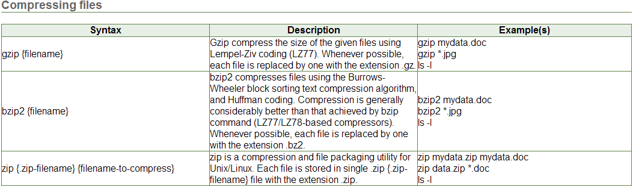
Utilities : File Compression
Notes:
student.txt
Jones
2143
78
84
77
Gondrol
2321
56
58
45
RinRao
2122
38
37
65

Slide 45
Utilities : File Compression
gzip reduces the size of the named files using Lempel-Ziv coding (LZ77).
By default, gzip keeps the original filename and timestamp in the compressed file
Compressed files can be restored to their original form using gzip -d or gunzip.
gunzip takes a list of files on its command line and replaces each file whose name ends with .gz, -gz, .z, -z, z, or .Z
zcat is used to display the content of compressed file it is identical to gunzip –c. (On some systems, zcat may be installed as gzcat to preserve the original link to compress.)
zcat uncompresses either a list of files on the command line or its standard input and writes the uncompressed data on standard output
Notes:
student.txt
Jones
2143
78
84
77
Gondrol
2321
56
58
45
RinRao
2122
38
37
65

Slide 46
Utilities : tar
Extracting (untar) an archive using tar command (Extract a *.tar file using option xvf)
$ tar xvf archive_name.tar
x – extract files from archive
Extract a gzipped tar archive ( *.tar.gz ) using option xvzf
Use the option z for uncompressing a gzip tar archive.
$ tar xvfz archive_name.tar.gz
View the tar archive file content without extracting using option tvf
$ tar tvf archive_name.tar
Extract a single file from tar, tar.gz file
$ tar xvf archive_file.tar /path/to/file
Notes:
student.txt
Jones
2143
78
84
77
Gondrol
2321
56
58
45
RinRao
2122
38
37
65

Slide 47
Utilities : tar
On Unix platform, tar command is the primary archiving utility.
Creating an uncompressed tar archive using option cvf
This is the basic command to create a tar archive.
$ tar cvf archive_name.tar dirname/In the above command:
c – create a new archive
v – verbosely list files which are processed.
f – following is the archive file name
Creating a tar gzipped archive using option cvzf
The above tar cvf option, does not provide any compression. To use a gzip compression on
the tar archive, use the z option as shown below.
$ tar cvzf archive_name.tar.gz dirname/
z – filter the archive through gzip
Notes:
student.txt
Jones
2143
78
84
77
Gondrol
2321
56
58
45
RinRao
2122
38
37
65

Slide 48
Job Scheduling : Cron
Enable your users to use the crontab command to create personal cron files under the /var/spool/cron directory, you should first create two files: /etc/cron.allow and /etc/cron.deny
Note: Be careful! Always use the crontab command’s -u command-line option. If you run this while running as root (after using the su command), and don’t use this option, you’ll edit the root operator’s crontab settings instead of your own.
Five PARAM
Minutes hour ‘day of month’ ‘month’ ‘day of week’
* * * * *
Notes:
student.txt
Jones
2143
78
84
77
Gondrol
2321
56
58
45
RinRao
2122
38
37
65

Slide 49
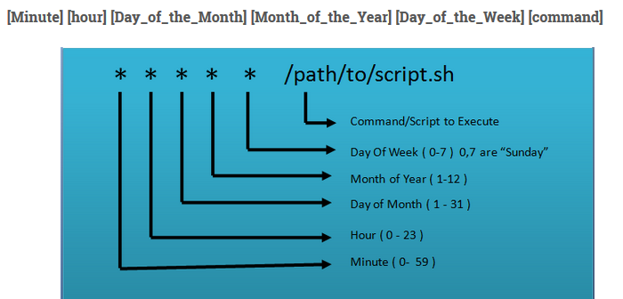
Job Scheduling : Cron
Notes:
student.txt
Jones
2143
78
84
77
Gondrol
2321
56
58
45
RinRao
2122
38
37
65

Slide 50
Job Scheduling : Cron
1. Schedule a cron to execute at 2am daily.
0 2 * * * /bin/sh backup.sh
Schedule a cron to execute twice a day
0 5,17 * * * /scripts/script.sh
Schedule a cron to execute on every Sunday at 5 PM.
0 17 * * sun /scripts/script.sh
Schedule a cron to execute on every 10 minutes
*/10 * * * * /scripts/monitor.sh
Schedule a cron to execute on selected months.
* * jan,may,aug * /script/script.sh
Schedule a cron to execute on selected days
0 17 * * sun,fri /script/script.sh
Schedule a cron to execute on every four hours
0 */4 * * * /scripts/script.sh
Schedule a cron to execute on every 30 Seconds
* * * * * /scripts/script.sh
* * * * * sleep 30; /scripts/script.sh
Notes:
student.txt
Jones
2143
78
84
77
Gondrol
2321
56
58
45
RinRao
2122
38
37
65

Slide 51
Shell Script Debugging
set -x
It enable the debugging of your shell scripts
set +x
It disable debugging of your shell scripts
Notes:
student.txt
Jones
2143
78
84
77
Gondrol
2321
56
58
45
RinRao
2122
38
37
65

Slide 52
THANKS!!

